Slide 1




Vidya Pratishthan’s Kamalnayan Bajaj Institute of Engineering and Technology, Baramati,
Department Of Artificial Intelliegence and Data Science
Artificial Intelligence (Mini Project)
Expert System: Employee performance evaluation

Slide 2

Problem Statement
To develop an expert system that automates and standardizes the employee performance evaluation process, reducing subjectivity and inefficiency while providing data-driven insights for effective workforce management
Objectives
Standardize the performance evaluation process across the organization
Reduce subjectivity and bias in performance assessments
Provide detailed insights into individual and overall employee performance
Enable data-driven decision-making for employee development and organizational strategies

Slide 3

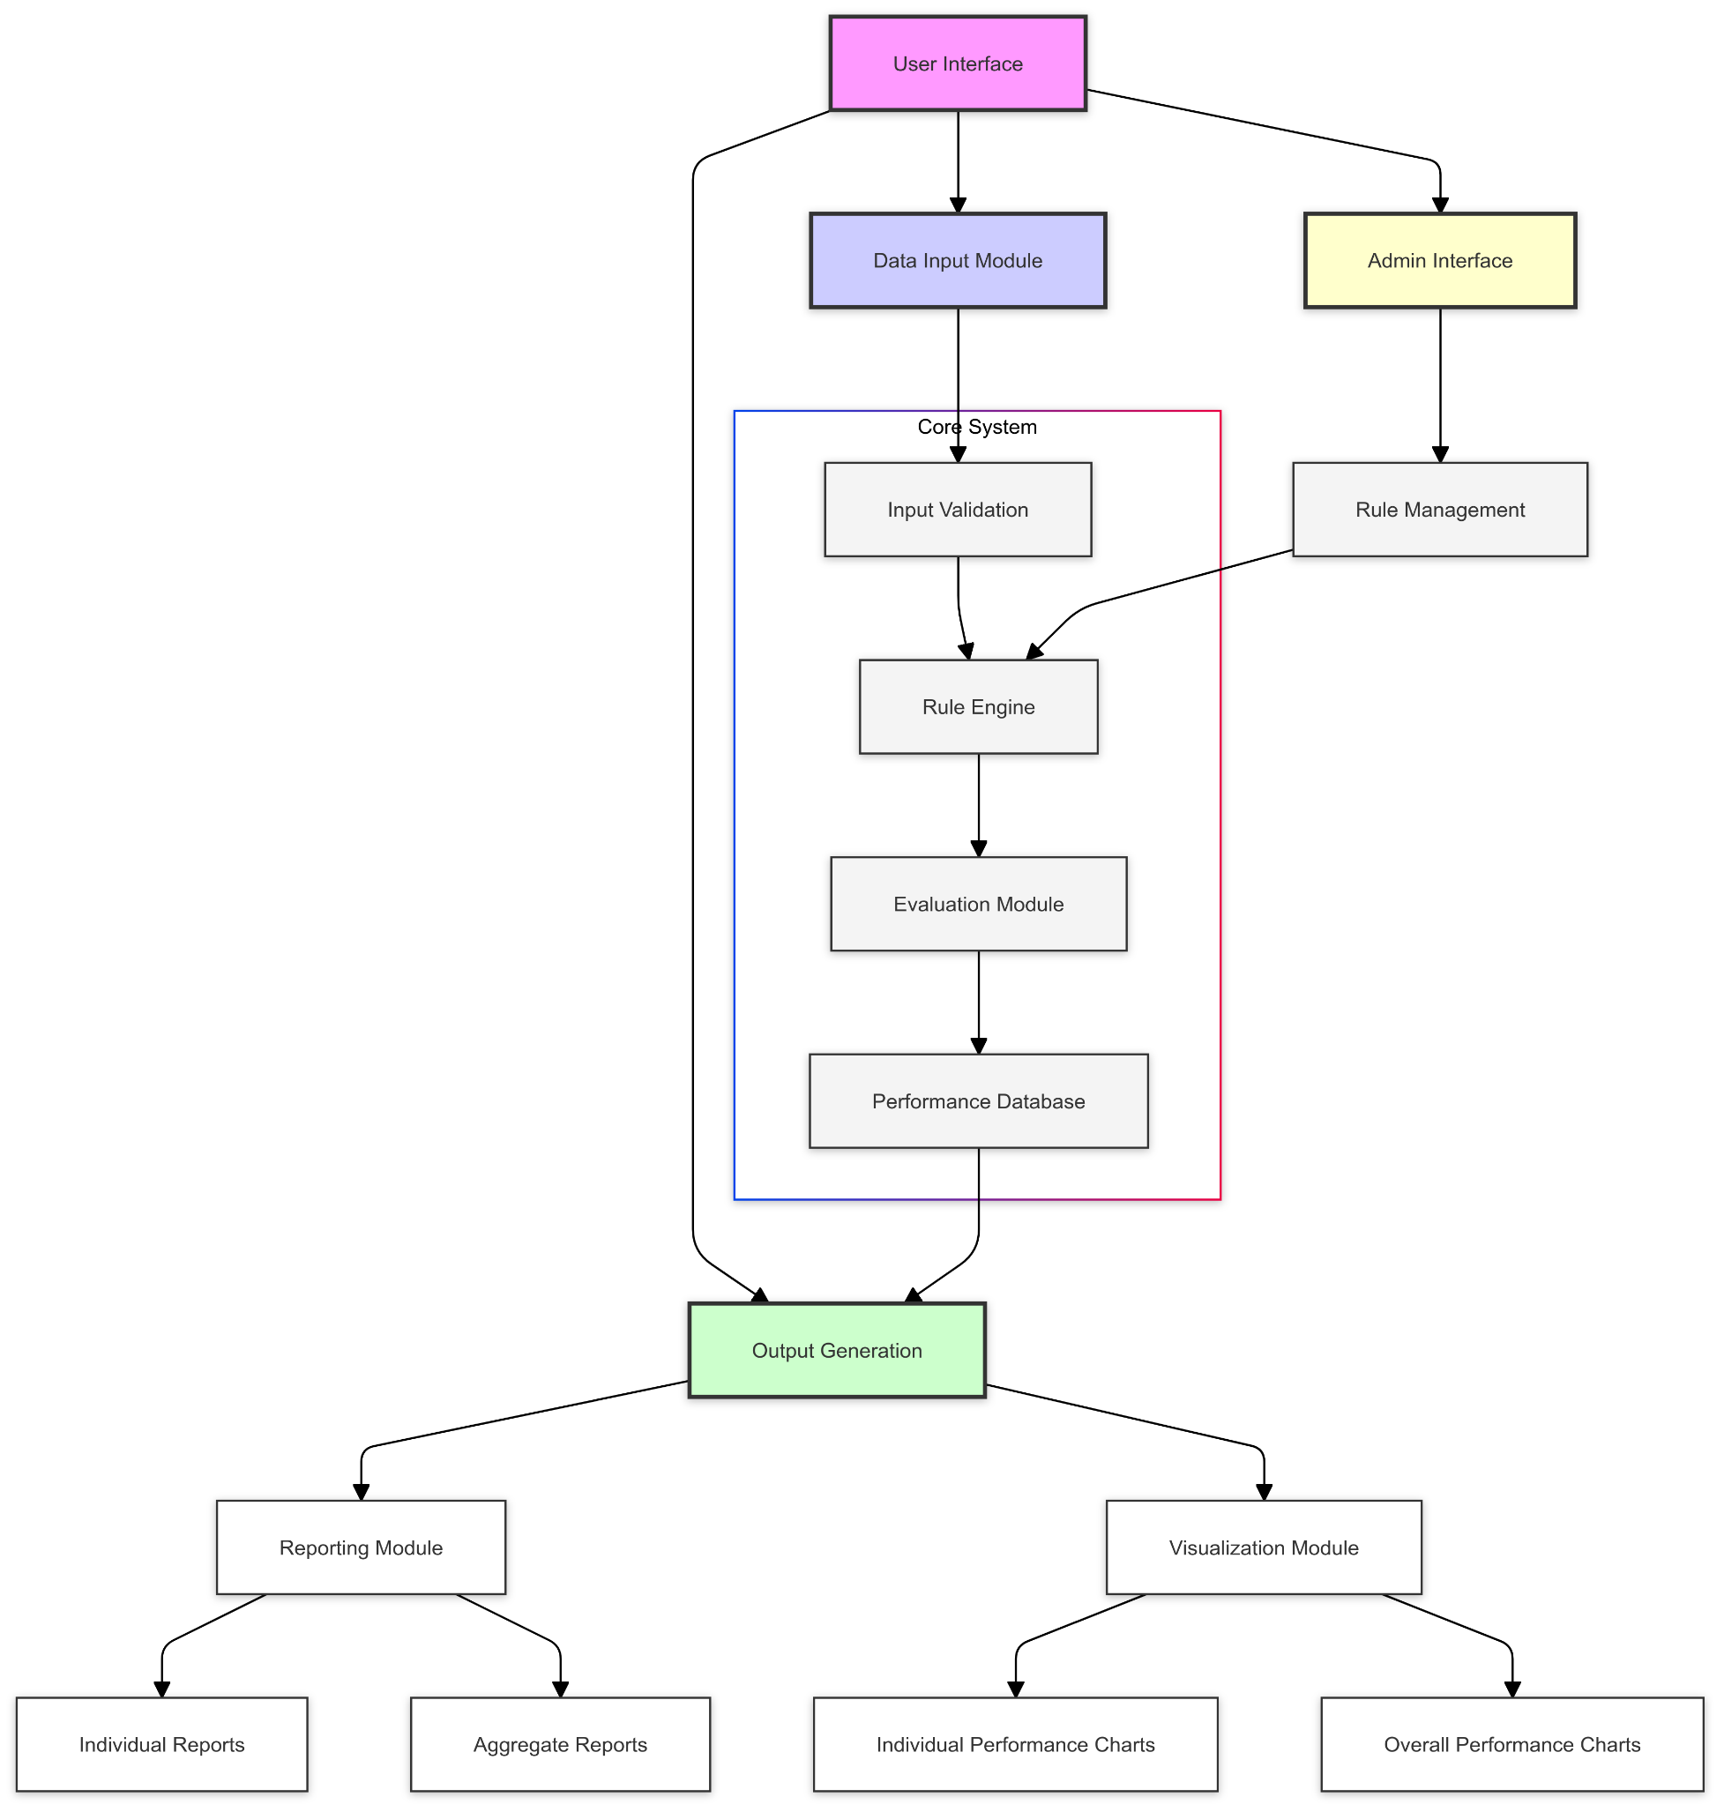
System Architecture
Components:
User Interface: Command-line interface for user interactions.
Data Input Module: Collects employee performance data.
Admin Interface: Modifies evaluation criteria and rules.
Core System: Includes input validation, rule management, rule engine and evaluation module.
Output Generation: Produces reports and visualizes performance data

Slide 4

Theoretical Foundation
Rule-based Expert System: Uses "if-then" logic for decision-making, mimicking human evaluations.
Key Performance Indicators (KPIs): Measures success across 8 areas (e.g.- Work quality, attendance, teamwork, initiative, punctuality, problem-solving, leadership, and innovation.)
Quantitative Analysis: Converts qualitative feedback into numerical data for statistical analysis.
Matplotlib Integration: Visualizes performance with bar charts for easier interpretation

Slide 5

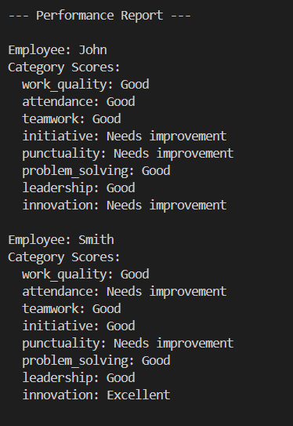
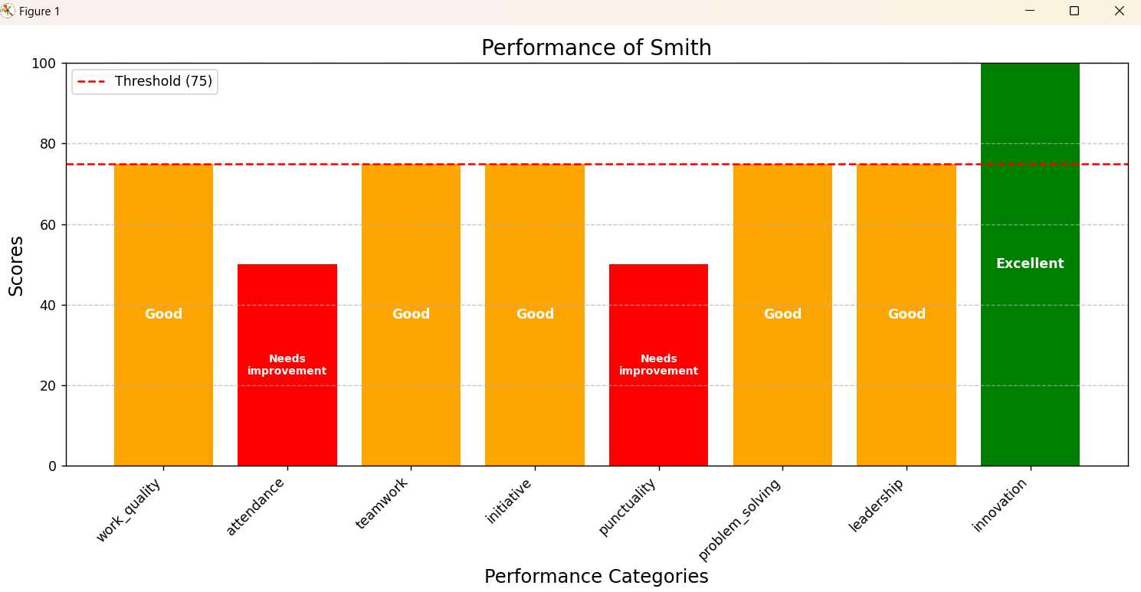
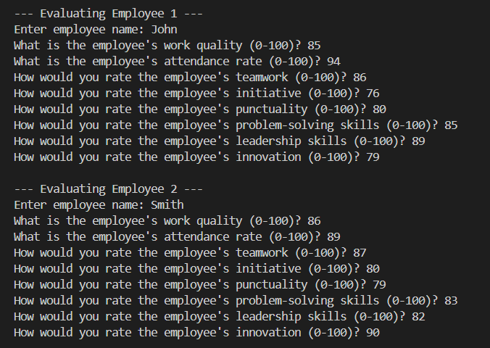
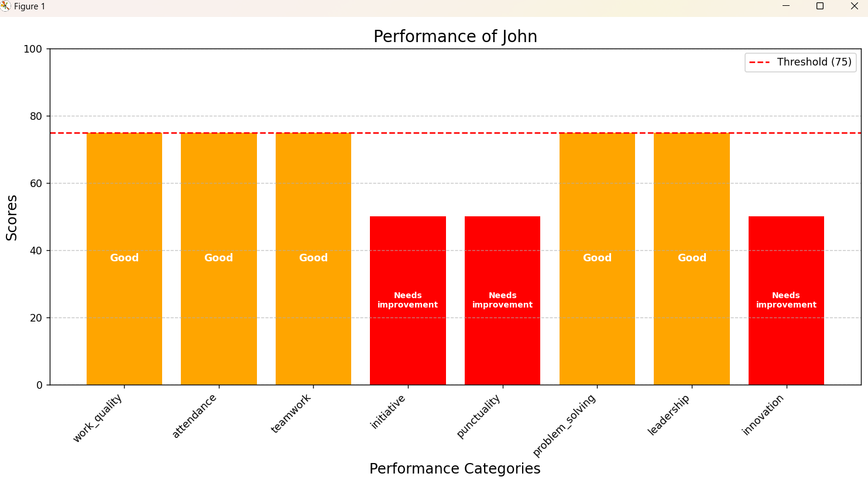
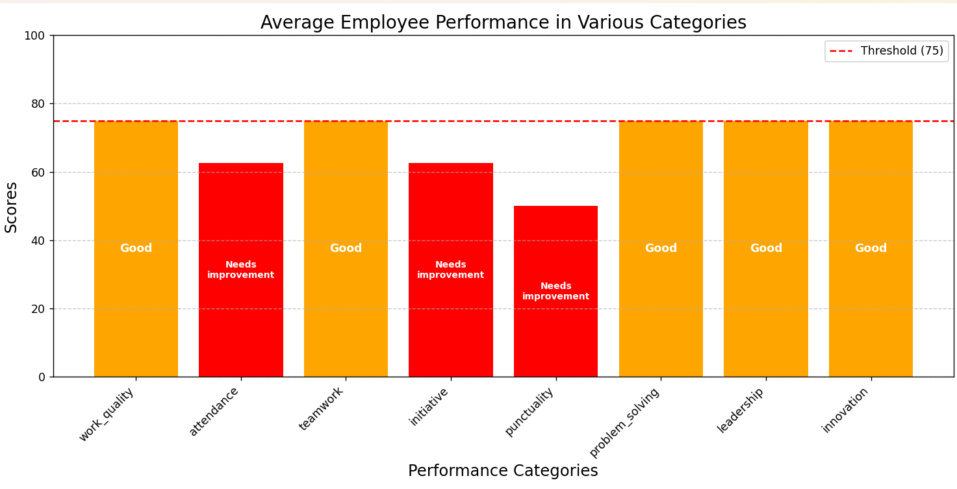

Slide 6
.
Advantages:
Reduces bias in evaluations.
Uniform evaluation across the organization.
Quantifiable metrics and visual reports.
Saves time and resources.
Disadvantages:
May not capture nuanced aspects of performance
Relies on accurate input data
Requires initial setup and maintenance
Focuses primarily on quantitative data

Slide 7

Future Scope
Machine learning for predictive insights.
Natural language processing for qualitative feedback.
Real-time performance tracking.
Integration with HR systems.
Mobile app development.
Personalized career development plans

Slide 8

Conclusion
The Employee Performance Evaluation Expert System provides a standardized, efficient, and unbiased way to assess performance, making it a valuable tool for informed employee development.

Slide 9

THANK YOU!!!

